Slide 1

MACHINE
INTELLIGENCE
Hidden Markov Model
K.S.Srinivas
Department of Computer Science and Engineering

Slide 2

MACHINE INTELLIGENCE
Discrete Markov Processes
K.S.Srinivas
Department of Computer Science and Engineering

Slide 3
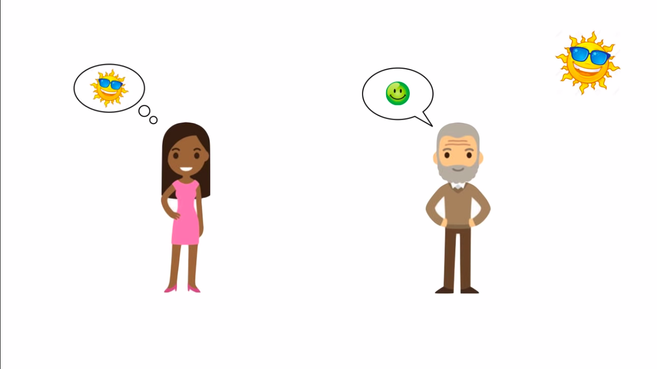
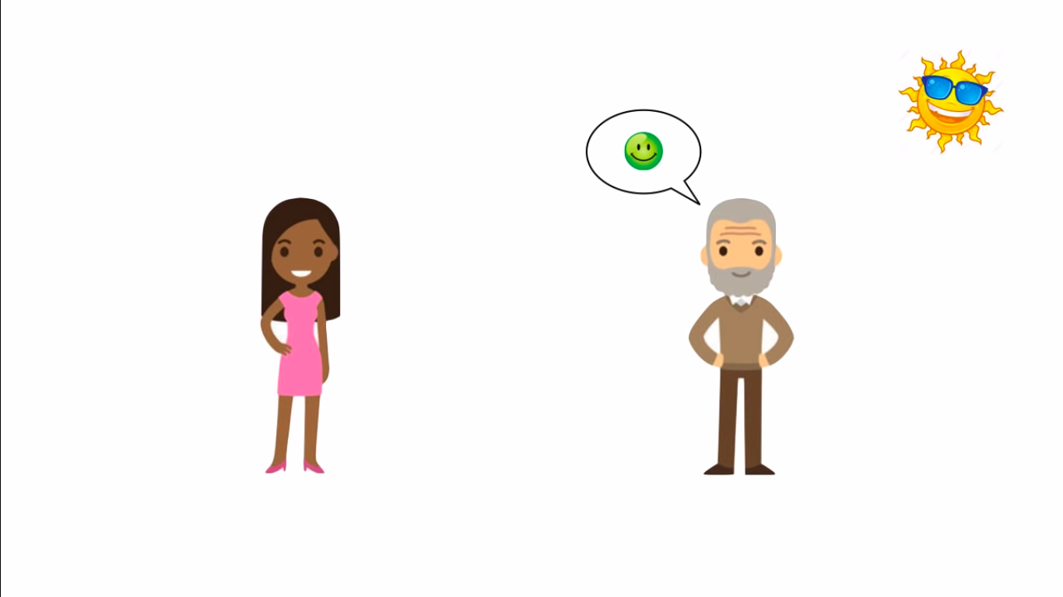


MACHINE INTELLIGENCE
HMM
Let us Recall the problem we framed
vijay says karan only his mood which is dependent on the weather
KARAN
VIJAY

Slide 4
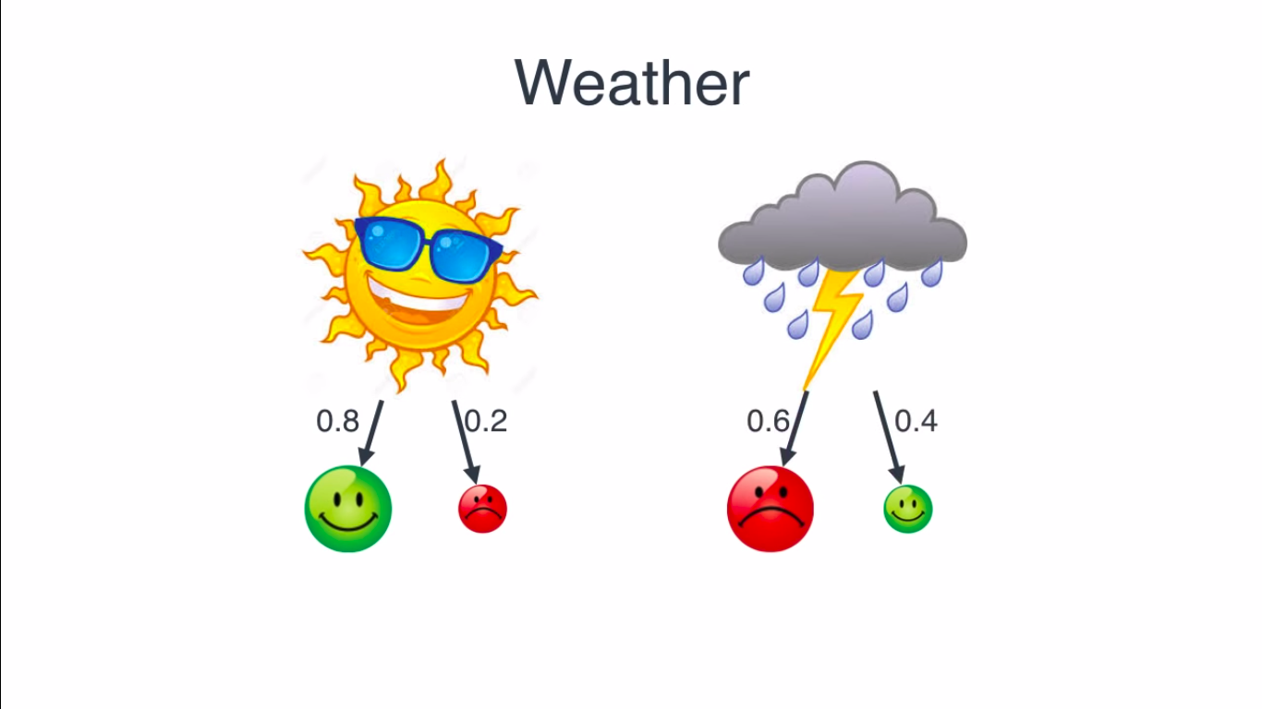
MACHINE INTELLIGENCE
HMM
weather can be sunny or rainy
if its sunny vijay is happy and if its rainy vijay is grumpy
so vijay tells karan his mood and he guesses the weather based on his mood

Slide 5
MACHINE INTELLIGENCE
HMM
now let say vijay is mostly happy when its sunny and mostly grumpy when its rainy
that is there are some exceptions,and say we have probabilities for this
0.6
0.4
0.8
0.2

Slide 6
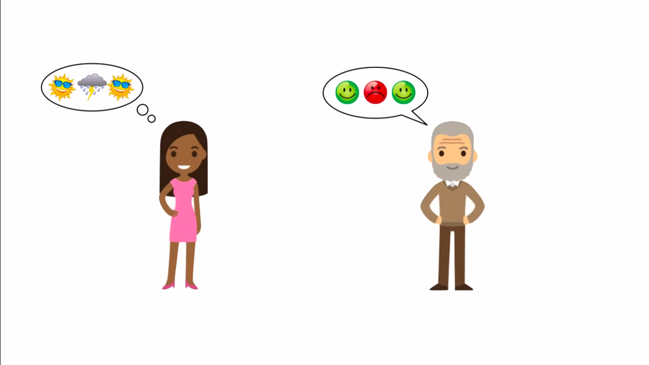
MACHINE INTELLIGENCE
HMM
so conversation between karan and vijay looks something like this

Slide 7
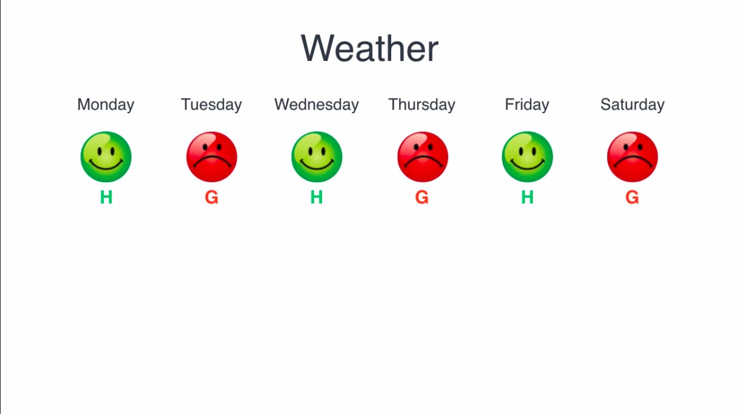
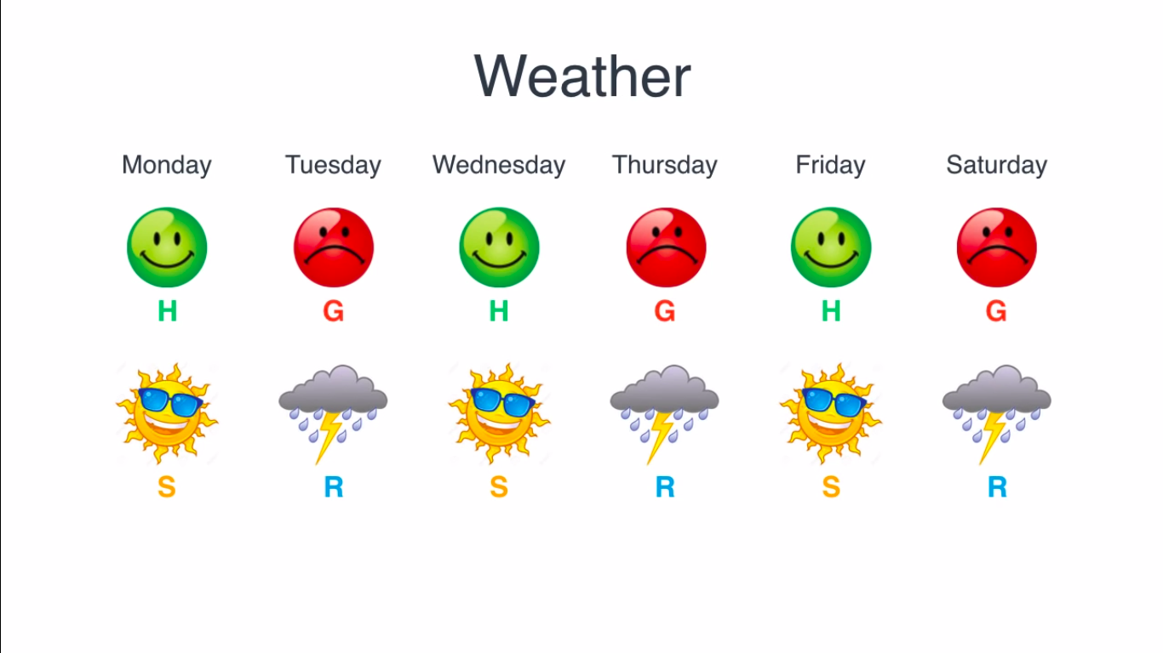
MACHINE INTELLIGENCE
HMM
so conversation between karan and vijay looks something like this
consider a week conversation between karan and vijay

Slide 8
MACHINE INTELLIGENCE
HMM
but does this unlikely ,its more likely that if a day say is sunny ,next day is going to be sunny and same with rainy

Slide 9
MACHINE INTELLIGENCE
HMM
lets get back to our model
lets say if today is sunny the probability that next day is sunny is 0.8,
then probability of next day being rainy is 0.2
similarly
0.8
0.2
0.6
0.4
0.4
0.8
0.2
0.6

Slide 10
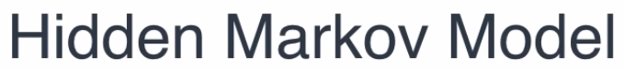
MACHINE INTELLIGENCE
HMM
what we have now is our hidden markov model
this HMM has two states
some observations we can see
and weather is the hidden states
0.8
0.2
0.6
0.4
0.4
0.8
0.2
0.6

Slide 11
MACHINE INTELLIGENCE
HMM
this is called transition probability
0.8
0.2
0.6
0.4
0.4
0.8
0.2
0.6

Slide 12
MACHINE INTELLIGENCE
HMM
this are called emission probability
0.8
0.2
0.6
0.4
0.4
0.8
0.2
0.6

Slide 13
MACHINE INTELLIGENCE
HMM
How did we find these probabilities?
Whats the probability that a random day is sunny or rainy
if Vijay is happy today,whats the probaility ,that its sunny or rainy?
if for three days Vijay is Happy,Grumpy,Happy,what was the weather
we will try to answer four question now

Slide 14
MACHINE INTELLIGENCE
How do we find probabilities?
lets say we some data that we looked at and that we've been able to study the past weathers
so we have the following data

Slide 15
MACHINE INTELLIGENCE
How do we find probabilities?
lets say we some data that we looked at and that we've been able to study the past weathers
so we have the following data
and we are going to infer probabilities from this
8 such transition
0.8
2 such transition
0.2
2 such transition
0.4
3 such transition
0.6

Slide 16
MACHINE INTELLIGENCE
How do we find probabilities?
now consider the vijay's mood on these days
from these we can calculate emission probability
0.8
0.2
0.4
0.6
8 such transition
0.8
2 such transition
0.2

Slide 17
MACHINE INTELLIGENCE
How do we find probabilities?
now consider the vijay's mood on these days
from these we can calculate emission probability
0.8
0.8
0.2
0.2
0.4
0.6
2 such transition
0.4
3 such transition
0.6

Slide 18
MACHINE INTELLIGENCE
HMM
How did we find these probabilities?
Whats the probability that a random day is sunny or rainy
if Vijay is happy today,whats the probaility ,that its sunny or rainy?
if for three days Vijay is Happy,Grumpy,Happy,what was the weather

Slide 19
MACHINE INTELLIGENCE
What is the probability that a random day is sunny or rainy
Suppose vijay didnt want to talk to karan,now karan has to figure out what weather it is
let us get the data back
let us calulate probability of sunny or rainy
looks cheating,lets use some other method
10
2/3
5
1/3

Slide 20
MACHINE INTELLIGENCE
What is the probability that a random day is sunny or rainy
0.8
if today is sunny it could be becuse yesterday was sunny ,or yesterday was rainy
we can have the following equation
0.4
S=0.8S+0.4R

Slide 21
MACHINE INTELLIGENCE
What is the probability that a random day is sunny or rainy
0.8
0.2
similarly
so now we can solve the system of these equation,but this two equation are almost same ,but we know that S+R=1
0.6
0.4
S=0.8S+0.4R
R=0.2S+0.6R
S+R=1
S=2/3 R=1/3

Slide 22
MACHINE INTELLIGENCE
HMM
How did we find these probabilities?
Whats the probability that a random day is sunny or rainy
if Vijay is happy today,whats the probaility ,that its sunny or rainy?
if for three days Vijay is Happy,Grumpy,Happy,what was the weather

Slide 23
MACHINE INTELLIGENCE
Question 3
we will use Bayes theorm
suppose today Vijay is happy
then there are two possibilities
since we are talking about particular day we need not care of transition probability
2/3
1/3
0.4
0.6
0.8
0.2

Slide 24
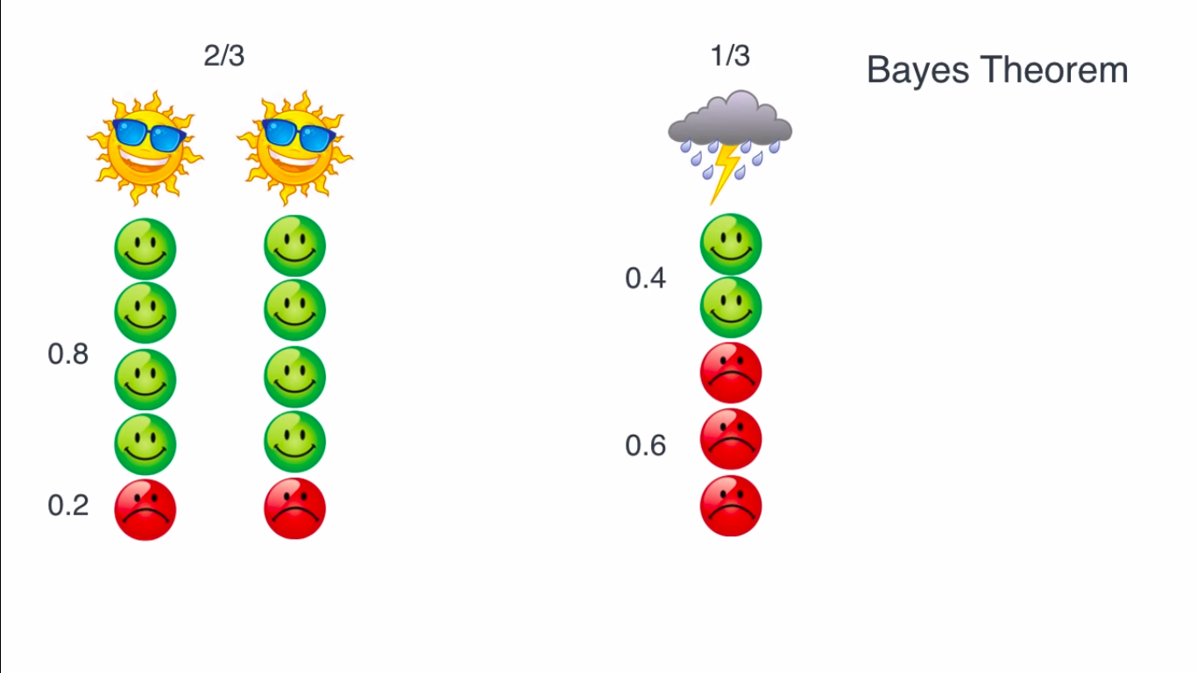
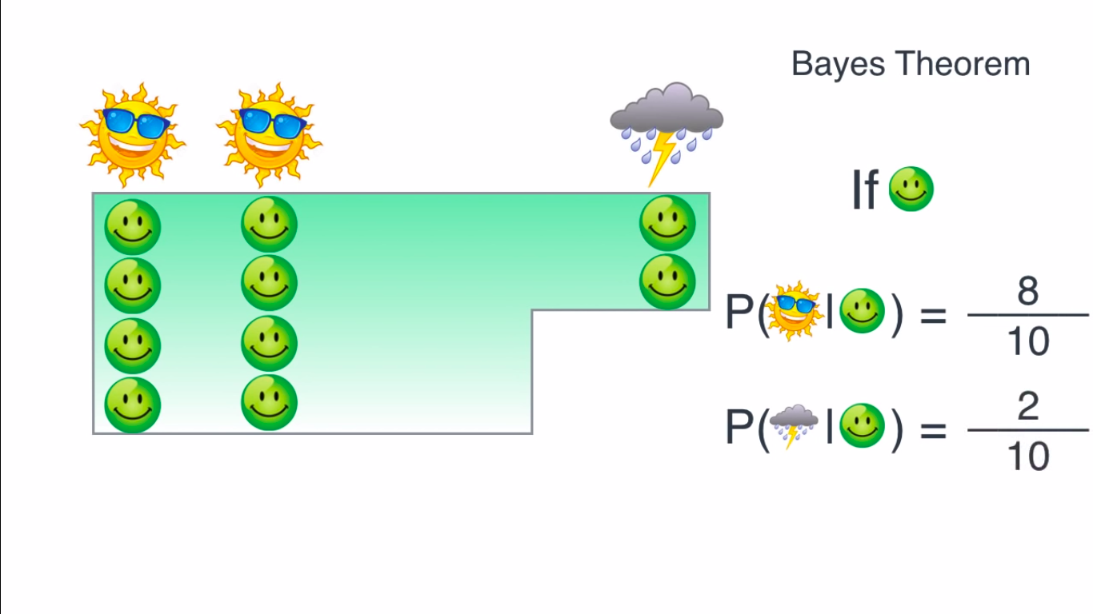
MACHINE INTELLIGENCE
HMM

Slide 25
MACHINE INTELLIGENCE
HMM

Slide 26
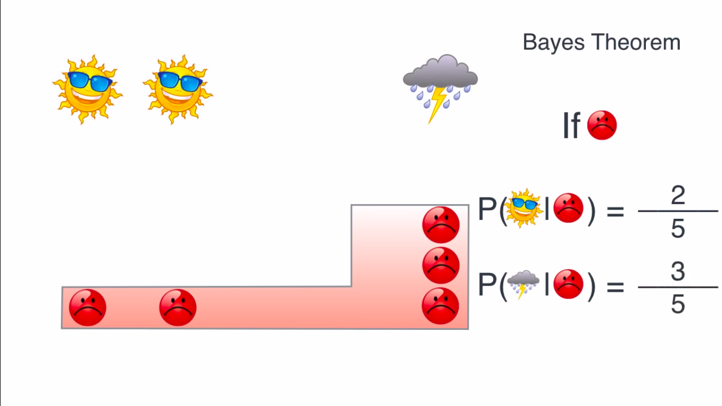
MACHINE INTELLIGENCE
HMM

Slide 27
MACHINE INTELLIGENCE
HMM
How did we find these probabilities?
Whats the probability that a random day is sunny or rainy
if Vijay is happy today,whats the probaility ,that its sunny or rainy?
if for three days Vijay is Happy,Grumpy,Happy,what was the weather

Slide 28
MACHINE INTELLIGENCE
final question
suppose vijay says happy grympy and happy for three consequective days
so karan is supposed to guess the weather now

Slide 29
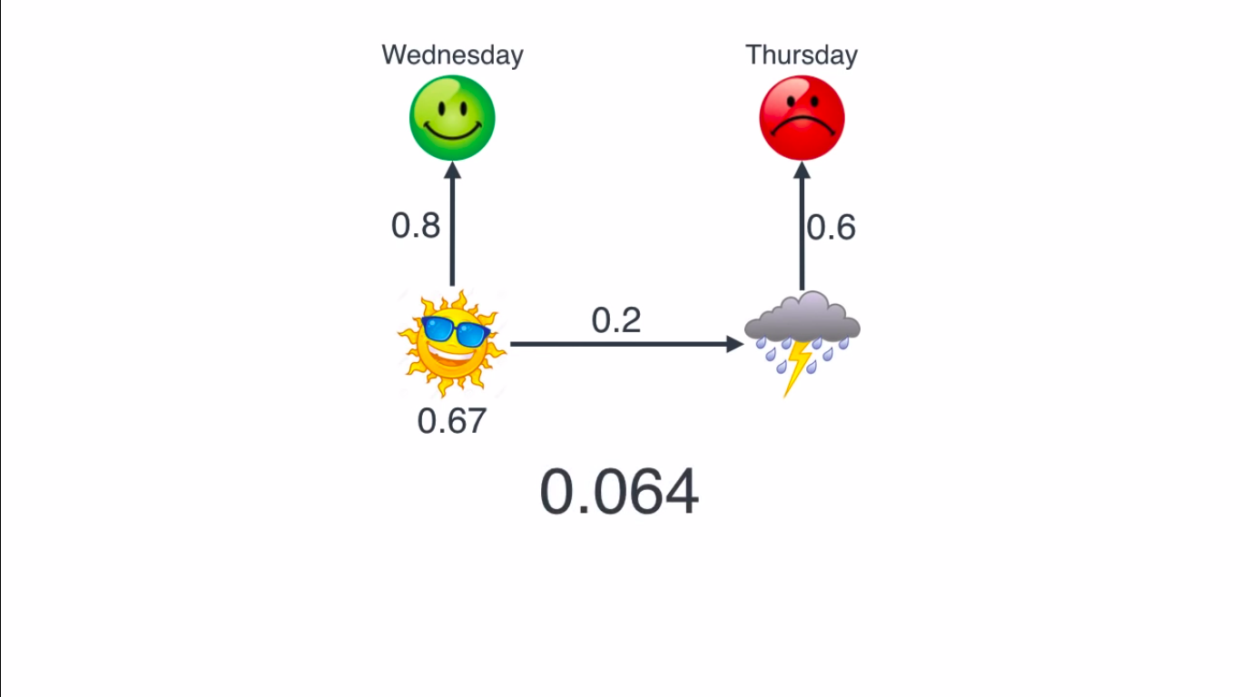
MACHINE INTELLIGENCE
HMM
lets look at a simpler case suppose we have two days
how many possible scenrarios do we have for the weather ???
so four cases to study

Slide 30
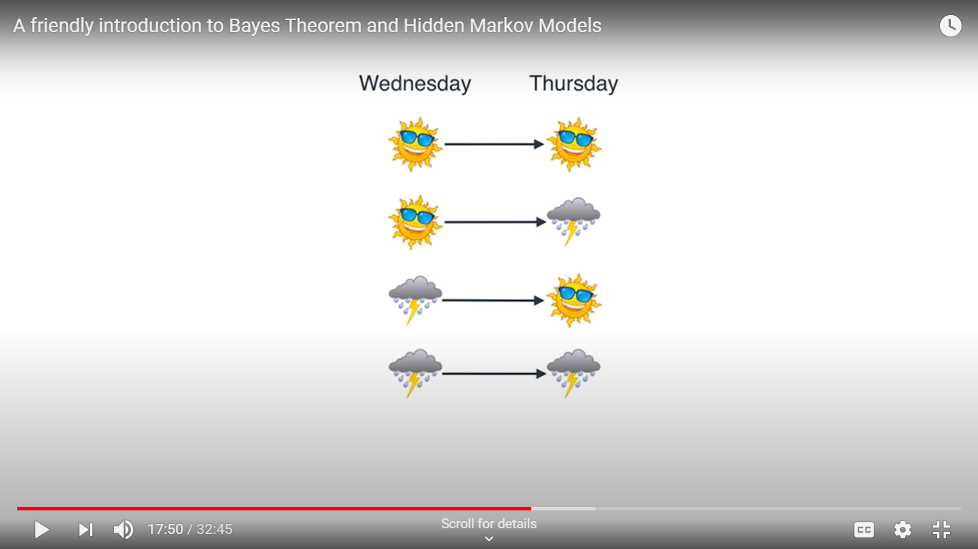
MACHINE INTELLIGENCE
HMM
what we will do is take each one of them and calculate probability that given these ways vijay was happy and then grumpy
and then we are going to pick whatever gave us the highest

Slide 31
MACHINE INTELLIGENCE
HMM
lets calculate the entire probability of all this happening at the same time

Slide 32
MACHINE INTELLIGENCE
HMM
what is the probability wednesday was sunny
we calulated previously that is 2/3=0.67
0.67

Slide 33
MACHINE INTELLIGENCE
HMM
now if wed was sunny what is the probability of vijay being happy
now given wed was sunny what was the probability that thursday being rainy
now thursday being rainy,what is the probabilty that made vijay grumpy
0.8
0.6
0.2
0.67

Slide 34
MACHINE INTELLIGENCE
HMM
now by law of conditional probability ,the probability of all this happening is product of all these
0.8
0.6
0.2
0.67
0.06432

Slide 35
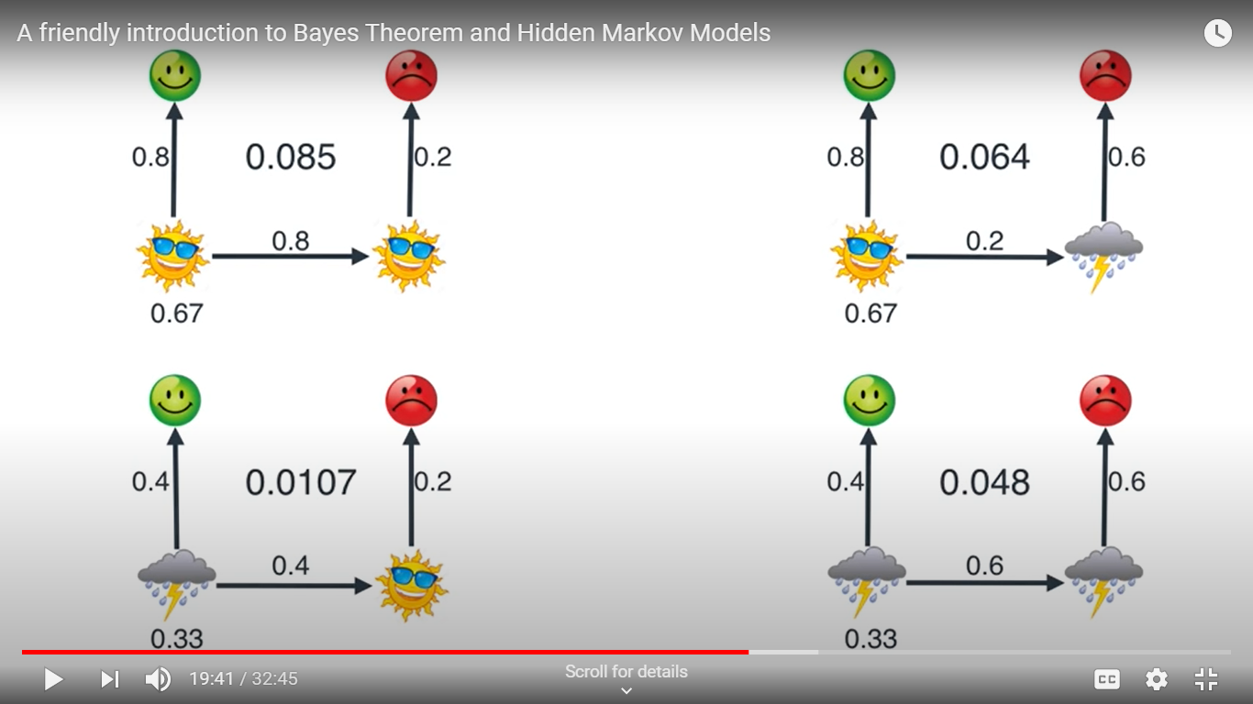
MACHINE INTELLIGENCE
HMM
doing the same for all the four case we get this results
we pick the one that is going to make happy grumpy likely happen

Slide 36
MACHINE INTELLIGENCE
HMM
now back to our question what if vijay says Happy,grumpy.happy

Slide 37
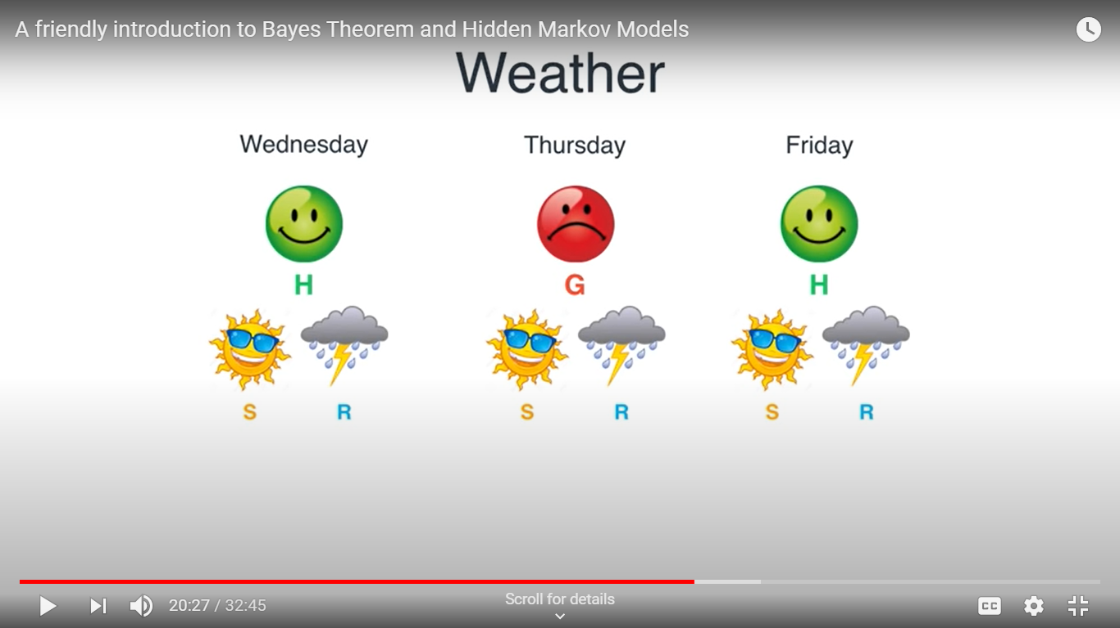
MACHINE INTELLIGENCE
HMM
Day1 Day2 Day3
same thing three days ,each with one mood ,and two possibilities for each day
hence 8 possible scenario

Slide 38
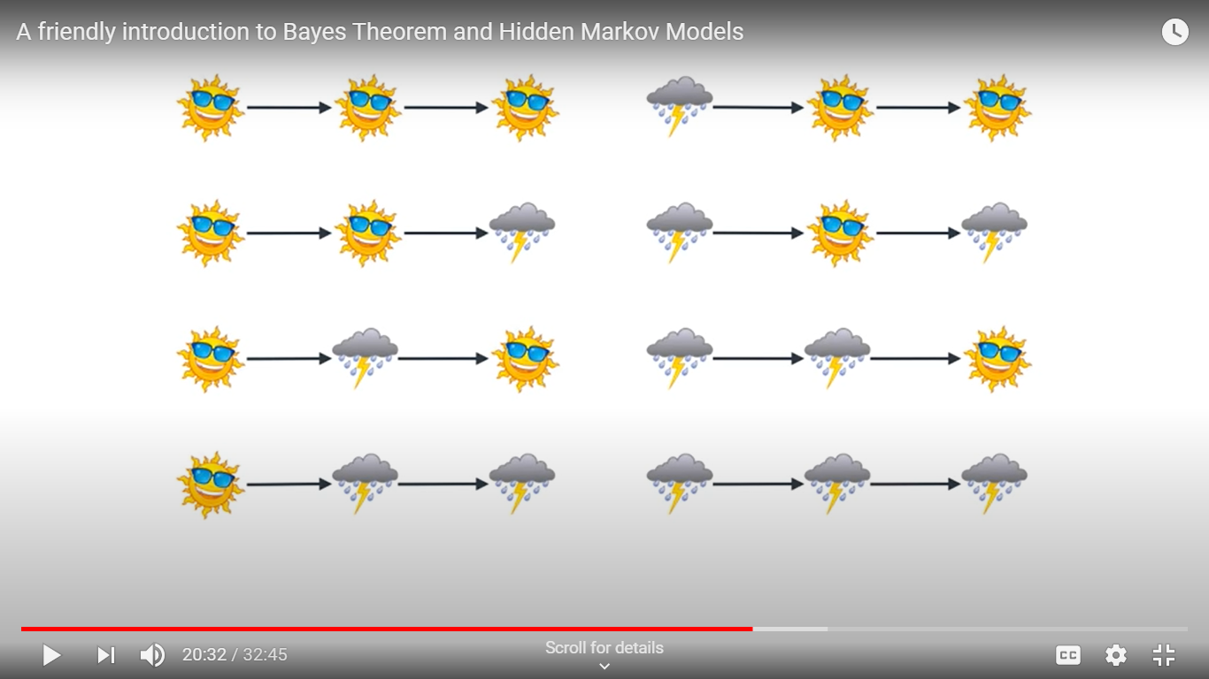
MACHINE INTELLIGENCE
HMM
same thing three days ,each with one mood ,and two possibilities for each day
hence 8 possible scenario

Slide 39
MACHINE INTELLIGENCE
HMM
Let us consider this case,sunny,rainy,sunny
0.8
0.8
0.6
0.2
0.4
0.67
0.0205824

Slide 40
MACHINE INTELLIGENCE
HMM
doing the same process for all the cases,we get max probability for this

